Slide 1

Contents
About AtliQ technologies and Problem Statement
Project Overview
Tables , Views , Functions and Stored Procedures
2021 Sales Report for Croma categorized by product.
Monthly Total Gross Sales Report for Croma
Annual Gross Sales Overview for Croma India
Key Market and Prime Customers in FY-2021
% of Net Sales contributed by Customers in the Market Share
% of Market Share by Region based on Net Sales
Supply Chain Forecast Quantity

Slide 2

About AtliQ Technologies and Problem Statement
AtliQ Hardware, a globally recognized leader in the manufacturing of PCs, printers, mice, and computers, has encountered performance challenges due to the growing size of their Excel files. These issues have caused delays and inefficiencies in their operations.
In response, AtliQ Hardware has launched a strategic initiative to resolve these challenges by assembling a dedicated team of data analysts. This team will utilize MySQL as their database management system to derive actionable insights from the company's data. These insights are expected to significantly improve decision-making processes and optimize operations, ultimately driving enhanced performance and efficiency across the organization.

Slide 3

Project Overview
This project aims to analyze and derive valuable insights from the provided database, encompassing sales, products, customers, and regions data for AtliQ Hardware. The objective is to address specific inquiries regarding sales reports, market analysis, customer behavior, and supply chain forecasting.

Slide 4

Objects that Store SQL Statements
TABLES
Tables in SQL are database objects that store data in a structured manner. They consist of rows and columns, where each column represents an attribute, and each row contains specific data values.
VIEWS
Views in SQL are virtual tables based on the result of a SELECT query. They provide a way to represent specific data subsets or join operations without altering the underlying database structure.
FUNCTIONS
Functions in SQL are reusable pieces of code that perform a specific operation on the database. They can accept parameters, process data, and return a result. Examples include mathematical operations and date functions.
STORED PROCEDURES
Stored Procedures in SQL are precompiled sets of one or more SQL statements that are stored in the database. They can be executed by invoking the procedure’s name and are useful for encapsulating complex logic or performing repetitive tasks.

Slide 5

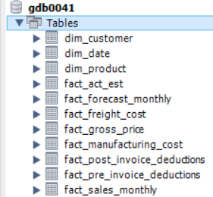
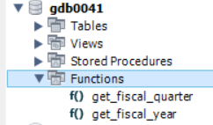

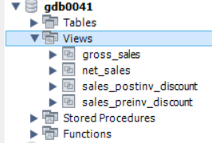
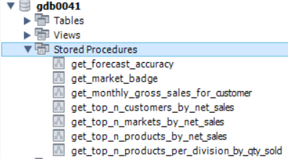
TABLES
VIEWS

Slide 6
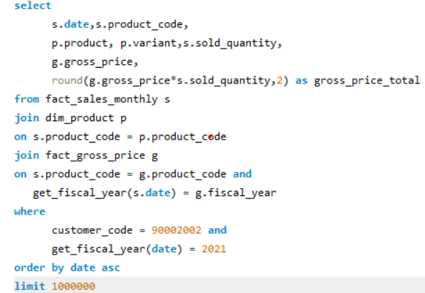
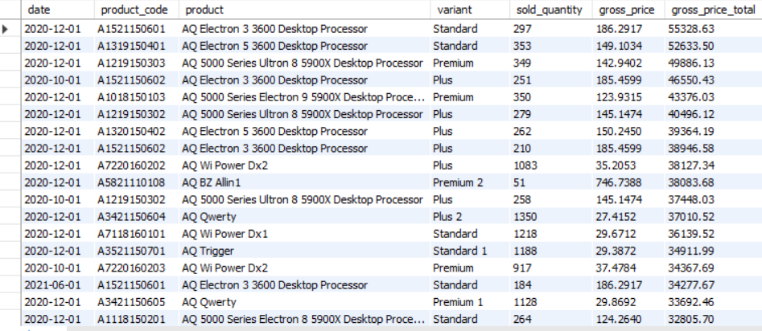
2021 SALES REPORT FOR CROMA CATEGORIZED BY PRODUCT
QUERY
OUTPUT

Slide 7
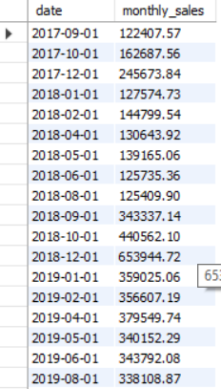
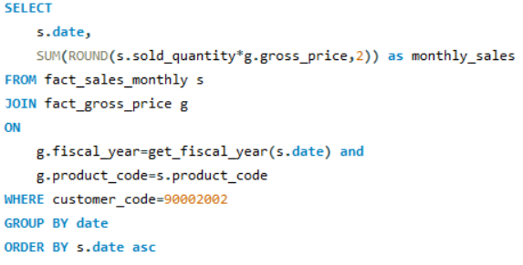
MONTHLY TOTAL GROSS SALES REPORT FOR CROMA
QUERY
OUTPUT

Slide 8
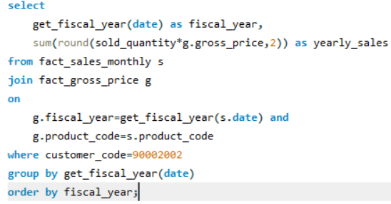
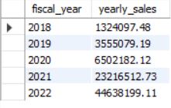
ANNUAL GROSS SALES REPORT FOR CROMA
QUERY
OUTPUT

Slide 9
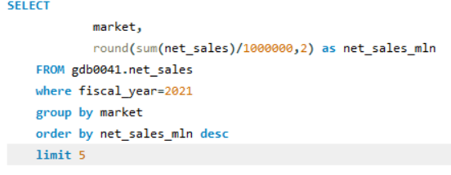
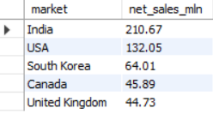
KEY MARKETS AND PRIME CUSTOMERS IN THE FINANCIAL YEAR-2021'
QUERY
OUTPUT

Slide 10
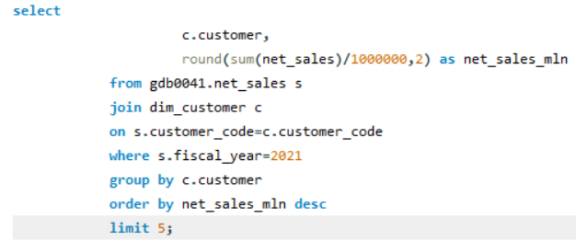
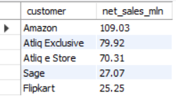
KEY MARKETS AND PRIME CUSTOMERS IN THE FINANCIAL YEAR-2021'
QUERY
OUTPUT

Slide 11
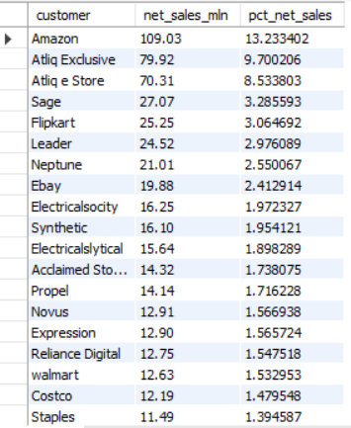
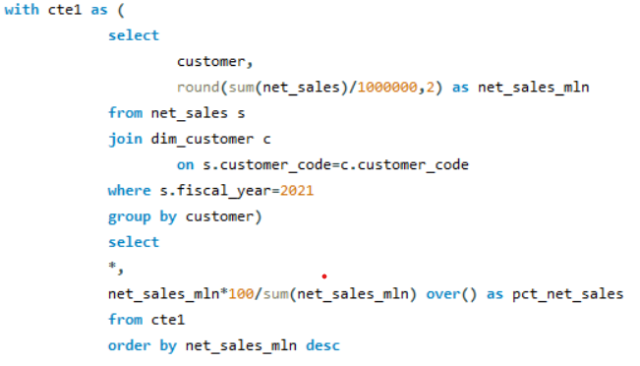
% OF NET SALES CONTRIBUTED BY CUSTOMERS IN THE MARKET SHARE
QUERY
OUTPUT

Slide 12
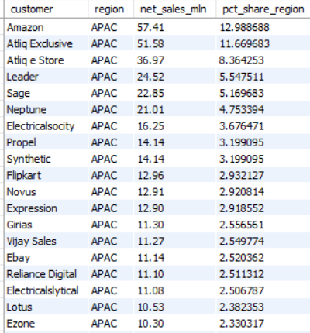
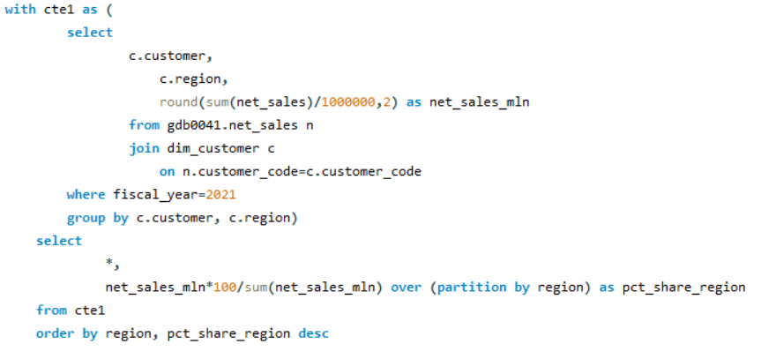
% OF MARKET SHARE OF CUSTOMERS BY REGION BASED ON NET SALES
QUERY
OUTPUT

Slide 13
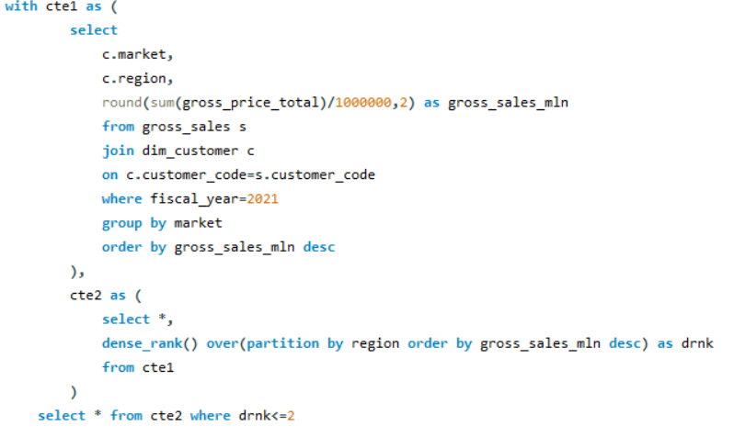
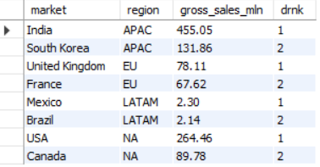
HIGHEST GROSS SALES IN EACH REGION'S TOP 2 MARKETS
QUERY
OUTPUT

Slide 14
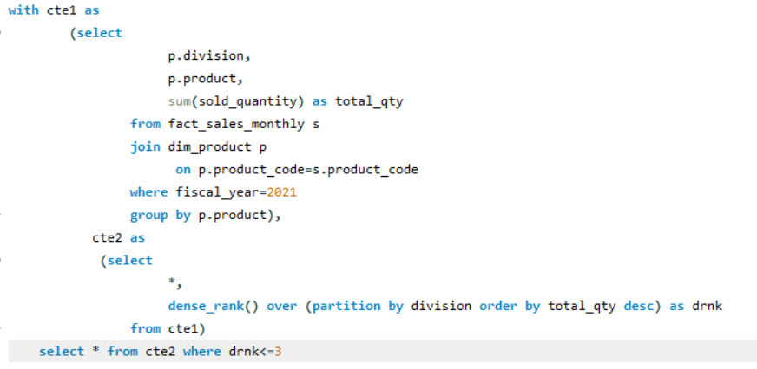
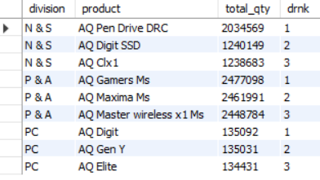
TOP 3 PRODUCTS FROM EACH DIVISION BY TOTAL QUANTITY SOLD IN FY 2021
QUERY
OUTPUT

Slide 15
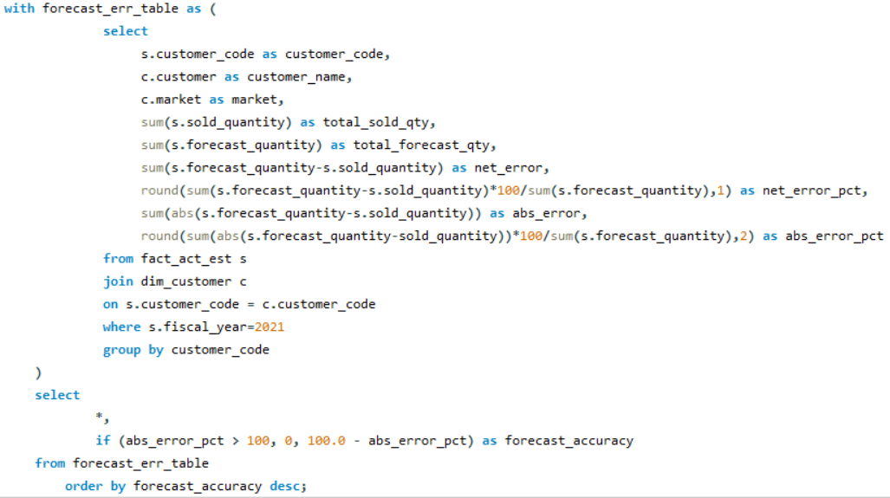
SUPPLY CHAIN - FORECAST QUANTITY -SQL QUERY

Slide 16
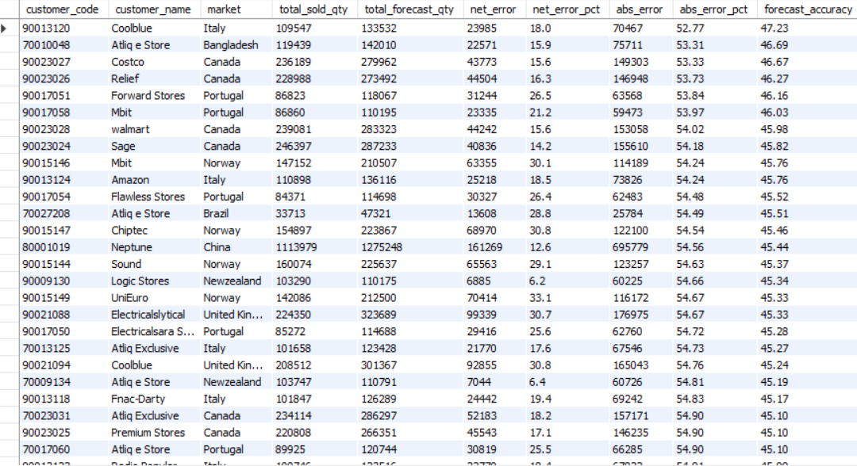
SUPPLY CHAIN - FORECAST QUANTITY -SQL OUTPUT

